Slide 1
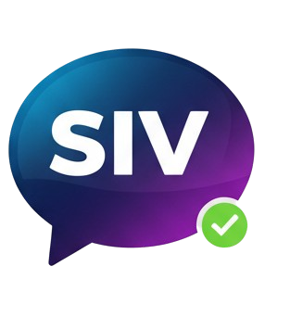

AI-Startup Idea Validator
Group : G566
Team Members:
23bd1a050z
23bd1a0502
23bd1a054x
23bd1a0547
23bd1a0546
Mentor Name: B Varsha
“An AI-driven platform for validating startup ideas.”

Slide 2

Problem Statement
Many founders have startup ideas but are unsure of their viability.
No structured or data-driven evaluation system exists.​
Founders rely on random opinions without factual analysis.​
Limited access to mentors and expert guidance.
Need for an AI-powered platform that evaluates and improves startup ideas.
“There is a clear gap between idea generation and professional validation — our system bridges
that gap using AI”

Slide 3
Existing Vs Proposed System
Existing System:
Proposed System:
Startup evaluation is mostly manual and subjective.
Entrepreneurs depend on mentors or incubators for idea feedback.
Feedback is inconsistent and lacks data-driven analysis.
Provides an AI-powered web platform for automated idea validation.
Uses OpenAI API to generate viability scores and feedback
Enables expert mentoring, semantic idea search, and secure cloud storage.
Supports user authentication, history tracking, and idea updates
“Startup Idea Lifecycle: Idea → Feedback → Validation → Launch”

Slide 4
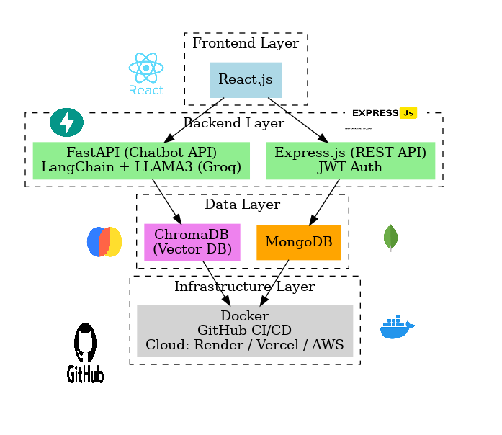







Technology Stack / Tools
Frontend: ReactJS for interactive UI.
Backend: Node.js + FastAPI for logic and AI orchestration.
Database: MongoDB + Pinecone for storage and semantic search.
AI: OpenAI for intelligent validation feedback.
Deployment: Vercel, Render for scalable hosting.
Security: JWT authentication , Crypto.
Pinecone DB
(vector DB)

Slide 5
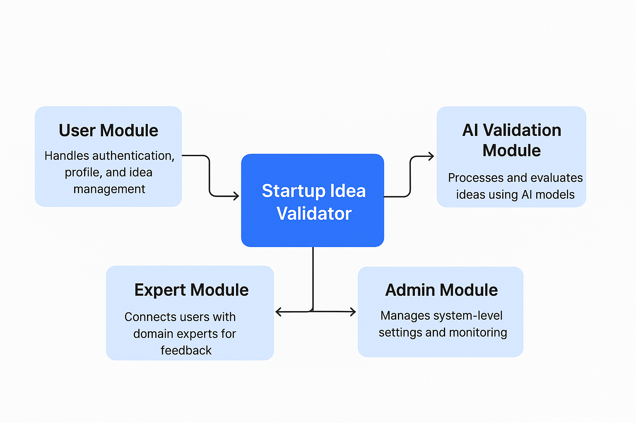
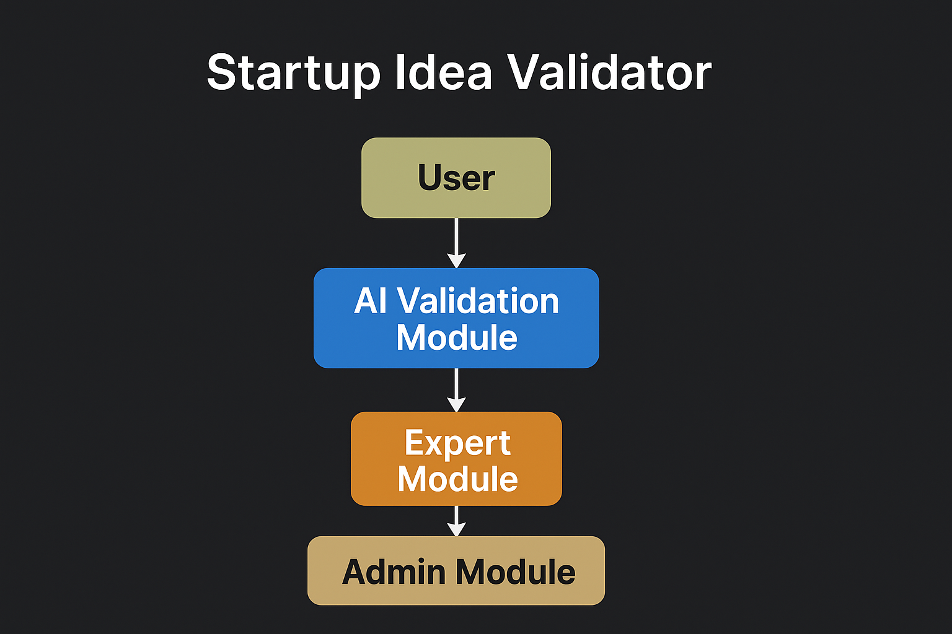
Modules
User Module – Handles authentication, profile, and idea management.
AI Validation Module – Processes and evaluates ideas using AI models.
Expert Module – Connects users with domain experts for feedback.
Admin Module – Manages system-level settings and monitoring.

Slide 6
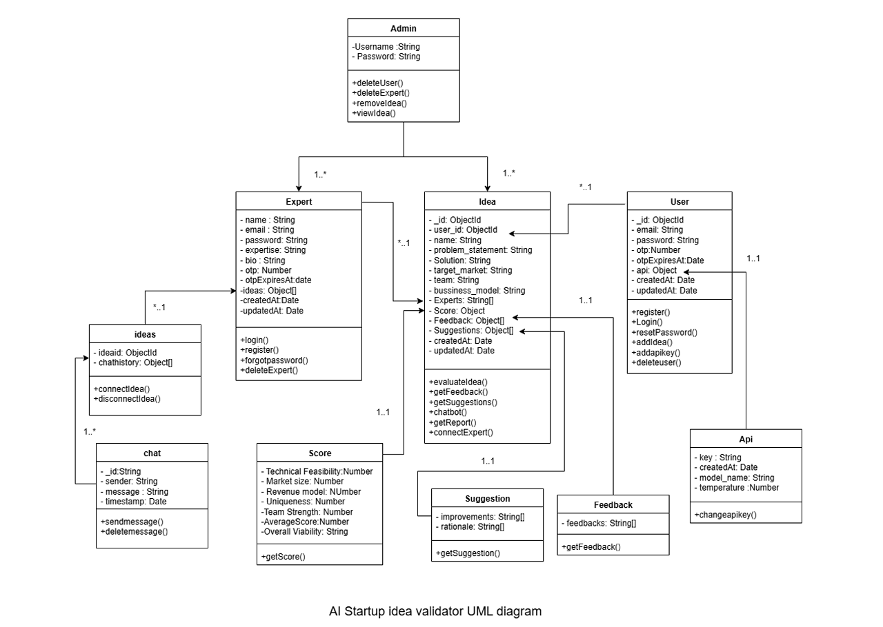

Slide 7
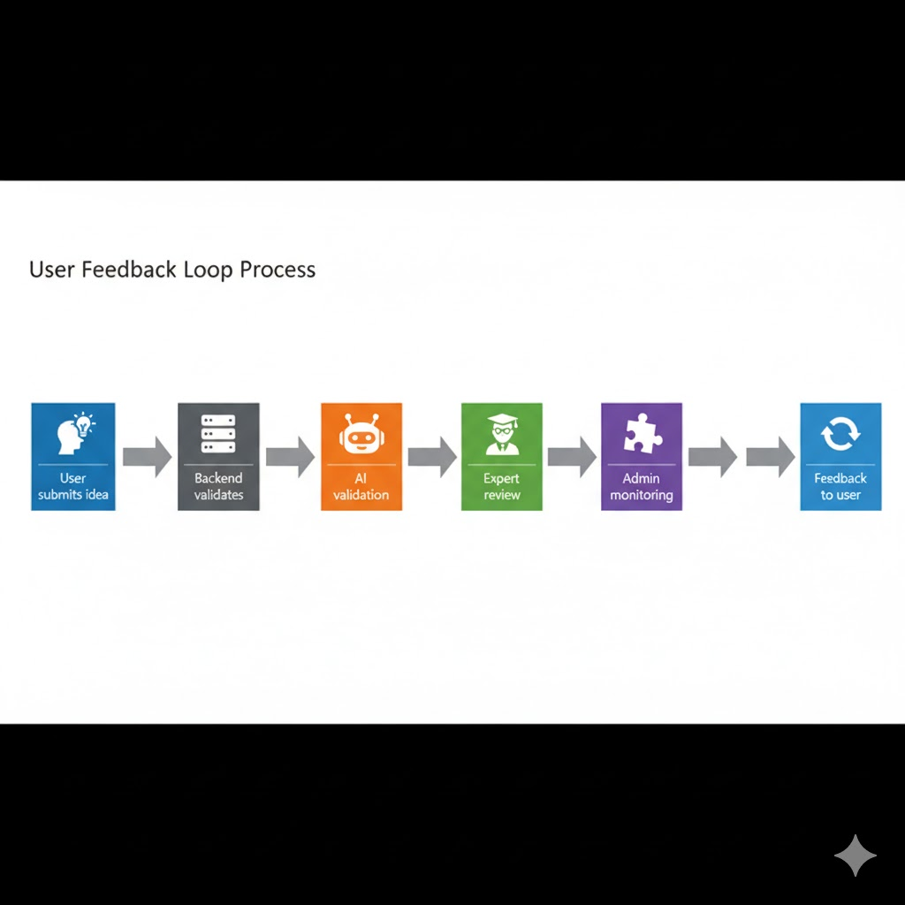
Work Flow
User Registration and authentication
Suggestions and Idea
User Registration and authentication
Idea Creation and Ai Validation
Connect with Expert

Slide 8
Future Scope
Enhance AI Chatbot for better productivity.
Monetization of Experts Module.
Introduce analytics dashboards for user and system insights.
Conclusion
Startup Idea Validator bridges the gap between ideation and execution.
It provides an AI-powered, structured evaluation framework.
The platform empowers innovators to refine their startup ideas effectively.

Slide 9
References
Smith, A. (2020) The Importance of Idea Validation in Startup Success. Journal of Entrepreneurship, 10(2), 45-58. ijlesjournal.org
Johnson, L. (2021) Machine Learning in Idea Validation: A Review of Methods and Applications. International Conference on Innovation., 121-135 researchgate.net.
Brown, R. (2019) Leveraging Data Analytics for Idea Validation: A Case Study of Innovative Startups. Journal of Data Science, 25(3), 301-315. sciencedirect

Slide 10
Thank You
Web Application : startupideavalidator.vercel.app
DEMO: LINK

